Slide 1
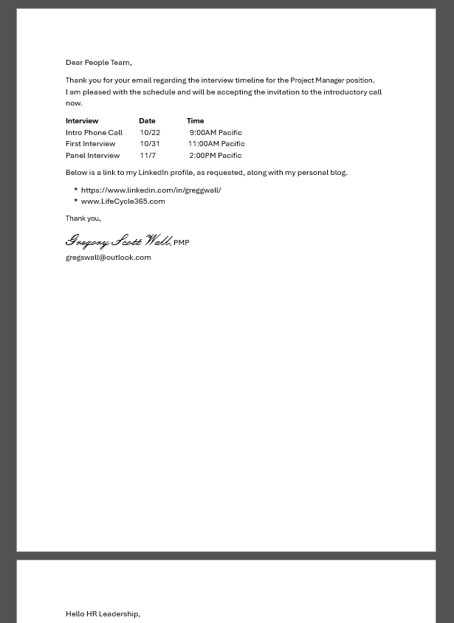
This document looks good, though that is only on the surface as it has obvious issues with its formatting and construction.
When reviewing the document, look for these items.
Consistent font use
Assignment of Styles
Paragraph construction
Left alignment of all text
Spacing between lines
Use of bullets
Tabs, tables, and spaces use for alignment
How the text got to the next page
Where are the sections
Are the links to the Web functional and correct

Slide 2
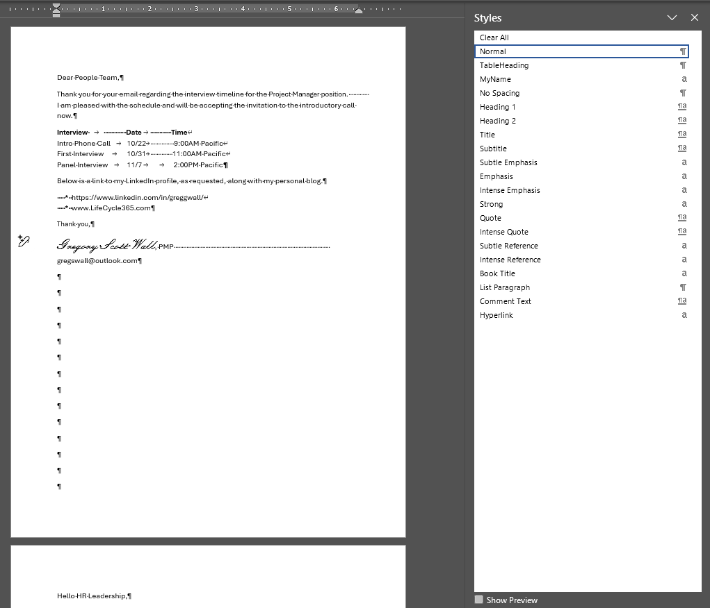
Let’s talk about each of the issues on this document with the ¶ mark tuned on.
Mix of Spaces and Tabs, should use a Table or Tab alignment
Not actually
aligned
This font is different than the rest of the document
Aptos Display (used)
Aptos Body (rest of the doc)
Used a few Spaces to indent the text and that is an Asterix, not a bullet
* The name on the side was manually formatted
None of these links actual Hyperlinks to the website or email
Use of Spaces to get the text on to the next line
* Manually formatted “Normal”
This may be the most obvious issue. The individual pressed Enter, Enter, Enter, Enter, Enter, and so on… to get the text to the next page.

Slide 3
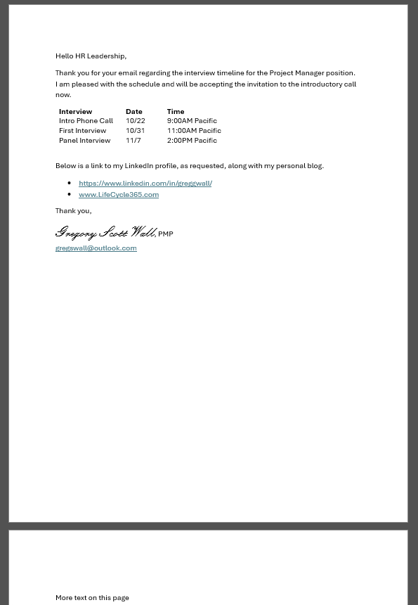
This document is the result of constructing the file correctly and a success.
When reviewing the document, look for these items.
Consistent font use
Assignment of Styles
Paragraph construction
Left alignment of all text
Spacing between lines
Use of bullets
Tabs, tables, and spaces use for alignment
How the text got to the next page
Where are the sections
Are the links to the Web functional and correct

Slide 4
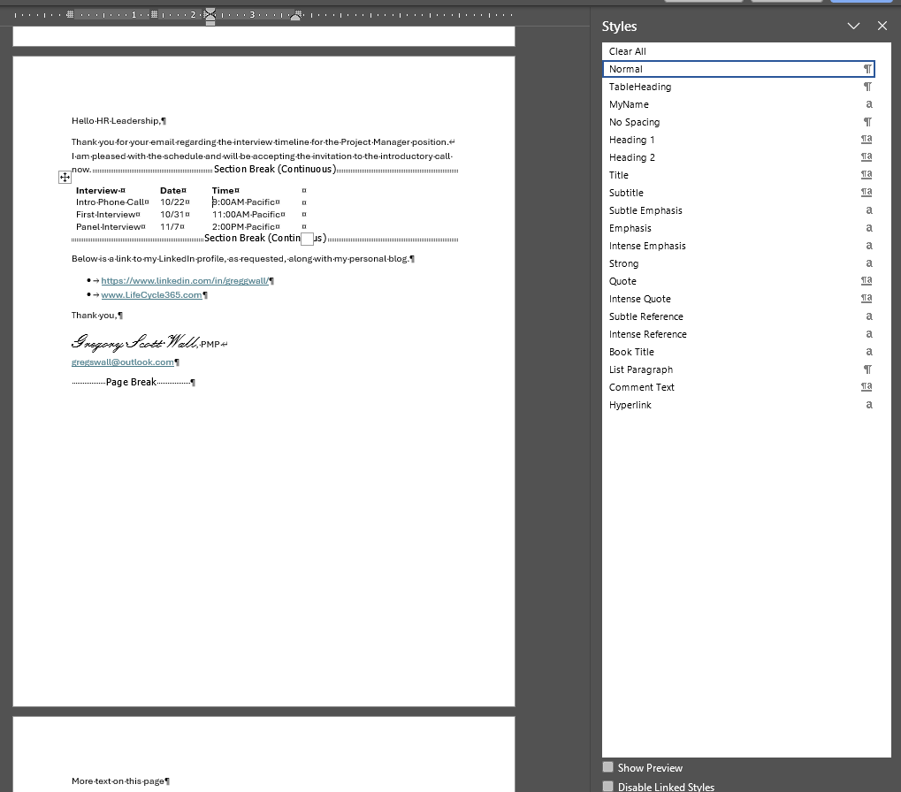
Let’s review why this document is correct with the ¶ mark on, showing the page markup.
Proper use of a Section Break on the page
A new Style was created on for the header row called TableHeading
Use of a Table to align the text
Used Bullets correctly
* New Styles created to ensure matching within the document.
These functional links are Hyperlinks to the website or email.
Use of Shift to get the text on to the next line
* New Style created for the signature called MyName
This text starts on the next pages because of the proper use of a Page Break

